Slide 1
Color/Fonts
Infographics
Mod 8: The goal of design is information, not decoration
Think of color and type as a voice

Slide 2
Monochromatic
Color schemes use different shades or tints of the SAME color. Choose a blue in your yearbook and use the same color with different shades or tints to create a great look in your book.
Complimentary
Complimentary colors (red and green) are situated opposite of each other on the color wheel. Use this color method when you want to create contrast in your yearbook
Mod 8: Creating Mood with Color and Type
Analogous
Colors appear next to each other on the color wheel. If you use two or three colors close to each other on the color wheel, you are creating a harmonious blend effect in your yearbook.

Slide 3
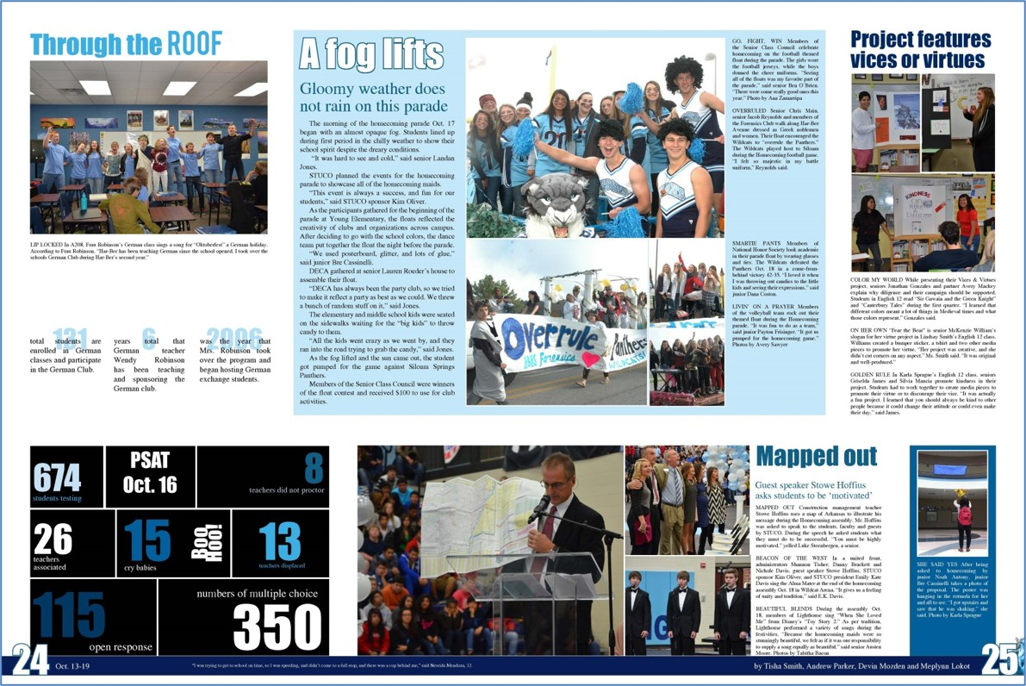
Monochromatic
Color schemes use different shades or tints of the SAME color. Choose a blue in your yearbook and use the same color with different shades or tints to create a great look in your book. (Shades of Blue)
Mod 8: Creating Mood with Color and Type

Slide 4
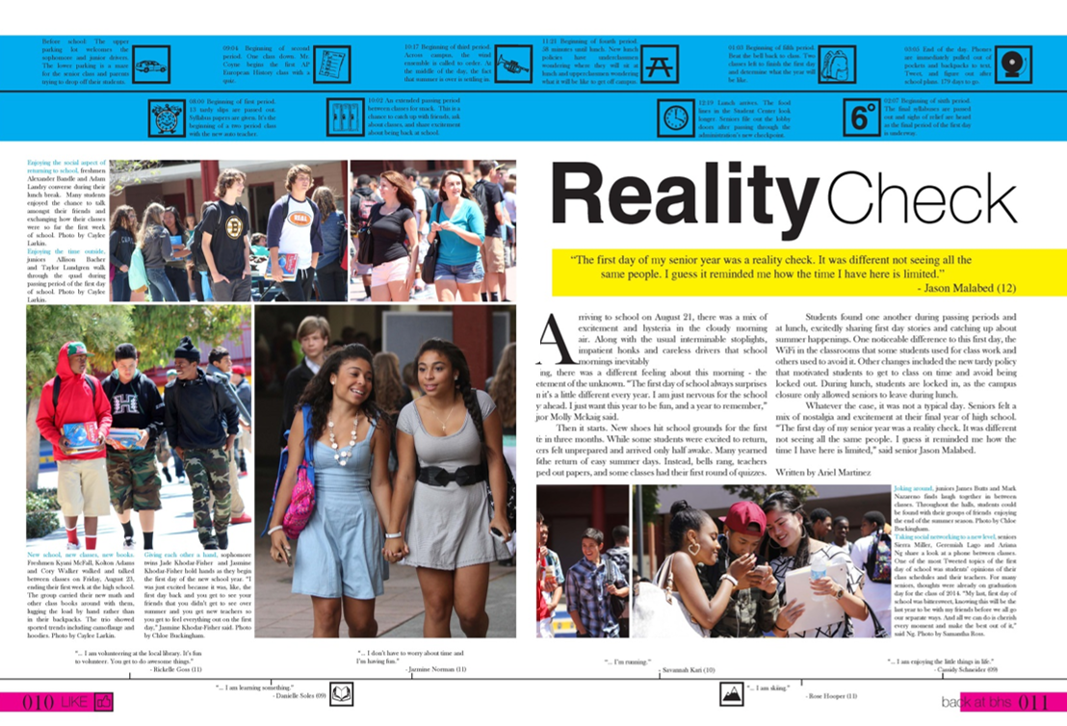
Complimentary
Complimentary colors (red and green) are situated opposite of each other on the color wheel. Use this color method when you want to create contrast in your yearbook. (Yellow vs Blue)
Mod 8: Creating Mood with Color and Type

Slide 5
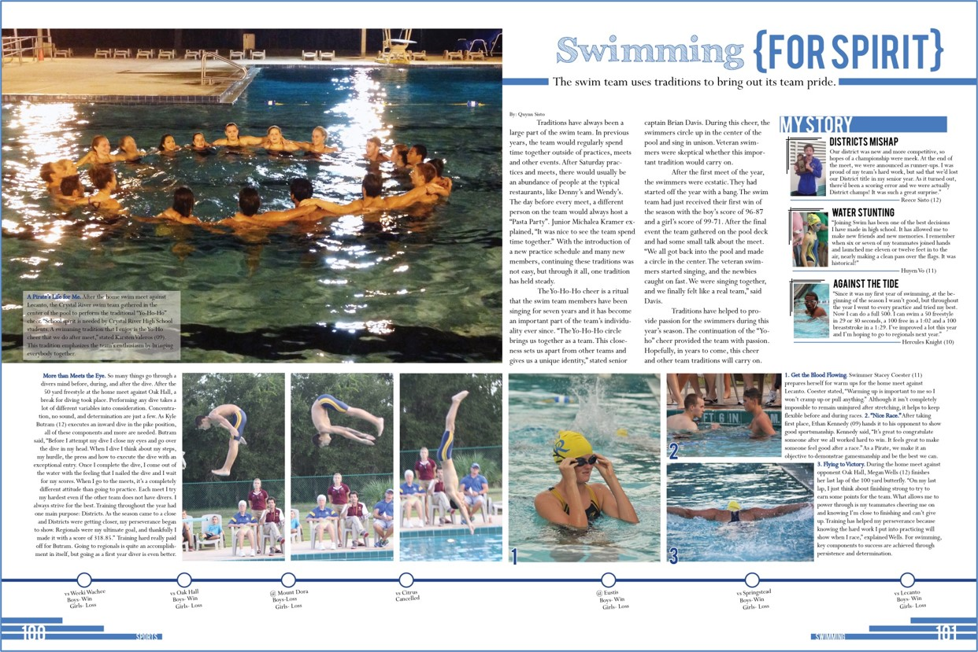
Analogous
Colors appear next to each other on the color wheel. If you use two or three colors close to each other on the color wheel, you are creating a harmonious blend effect in your yearbook. (Instead of shades of the same color, the school used light blue and dark blue.)
Mod 8: Creating Mood with Color and Type

Slide 6
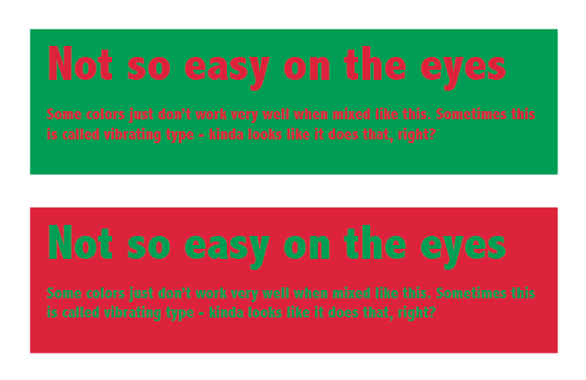
Color
Suggestions
Use color to draw attention to specific things
It is not a coloring book-all color
2. Color is a compliment to the content Creates the right mood for the reader
3. Think of the mood you want
Red is a more stimulating color while blue is more of a calming color
4. Consider your yearbook content
Monochromatic, complimentary, analogous
5. Yellow is the most irritating color
But first color that the eye notices
6. Be mindful of color and background Not so easy on the eyes
Mod 8: Six suggestions for using color in your yearbook

Slide 7
Serif
Body/Caption Fonts: These fonts are legible in small sizes, usually 8 – 14 points. Serif fonts (feet) are usually easier to read in long blocks of text, but San Serif fonts may also be used.
Sans Serif
These fonts have no feet. Sans serif fonts can be used for body copy or captions in your yearbook. "The quick brown fox jumps over the lazy dog"
Mod 8: Readibility is the key. Choose one font, either a serif or sans serif font for your body copy and captions. Stylize it as needed.
Decorative
Headline Fonts: Decorative fonts are used at larger point sizes for headlines, logos or for drawing attention with a small amount of text. They are not very legible at smaller point sizes.

Slide 8
Fonts
What you need to know
1. If people can’t read it, you are finished. Fonts have a “feel” – think about what they’re saying. This is a kindergarten font.
2. Decorative fonts should be used for emphasis only. Use one to three fonts for your headlines.
3. When mixing fonts, contrast is key. If using two different fonts, make sure they are DIFFERENT. If the two choices are too similar, it will read as a mistake.
4. Don’t use too many fonts. (Three to Five) Use differences in weight, size or case. Choose family (light, ultralight, bold, ultrabold, black, oblique, etc.).
5. Body Copy-9 or 10 pt for body copy is great. Use filler text to see how it looks.
Mod 8: Five Points to Consider when Working with Fonts

Slide 9
Fonts
What you need to know
Readability and tone are the focus when selecting typography. Your readers should focus on your words, not the font.
SINGLE-FONT STRATEGY: One font family, with lots of variations, is used for all headlines and possibly the stories and captions.
TWO-FONT STRATEGY: A serif family and a sans serif family, are teamed together with the serif font used for stories. Or, a single-font strategy can be teamed with an emphasis font.
Mod 8: Fonts Strategies-Try asingle-font or two-font strategy for your yearbook.

Slide 10
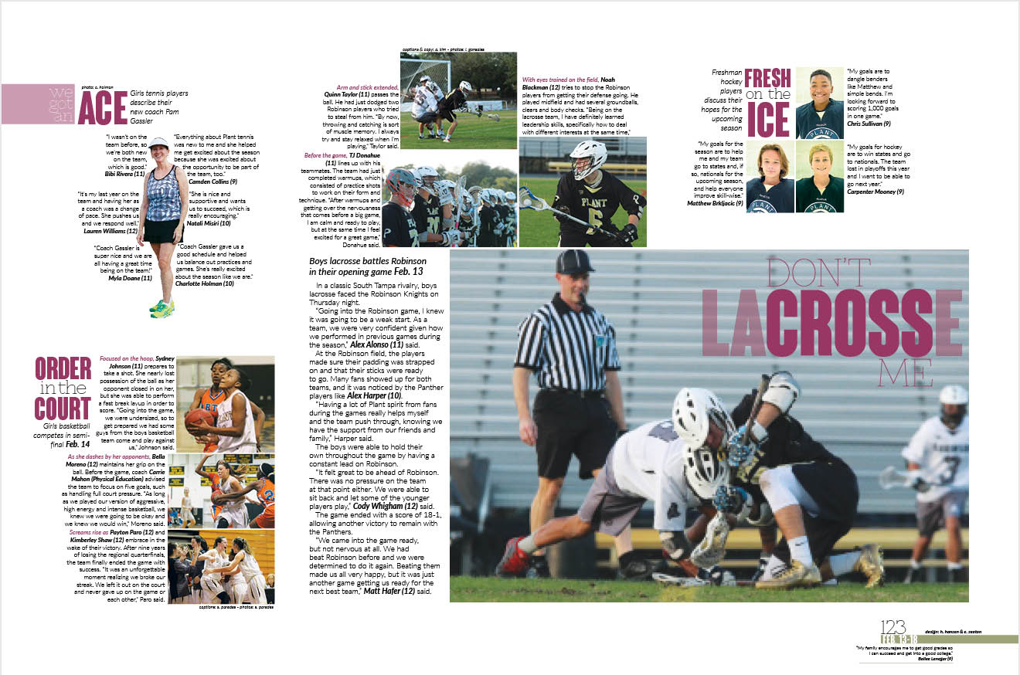
Fonts
What you need to know
Mod 8: Fonts Strategies- Example of single-font strategy

Slide 11
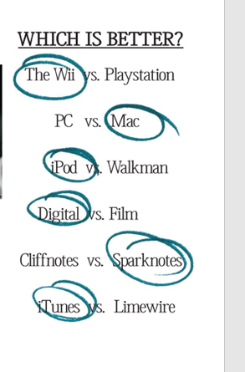
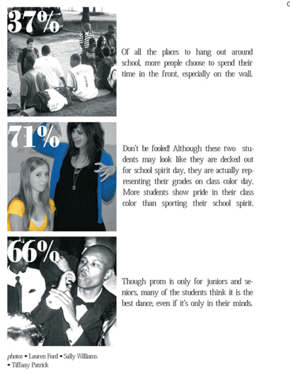
Engaging
By utilizing infographics, it can make the pages much more engaging and understandable.
More Information
Infographics can also be used to present extra information or a piece of a story in a unique looking way.
Mod 8: An infographic is a collection of imagery, charts, and minimal text that gives an easy-to-understand overview of a topic.
Creative
Infographics should be original and easy to create. They should add pizzaz to the spread.

Slide 12
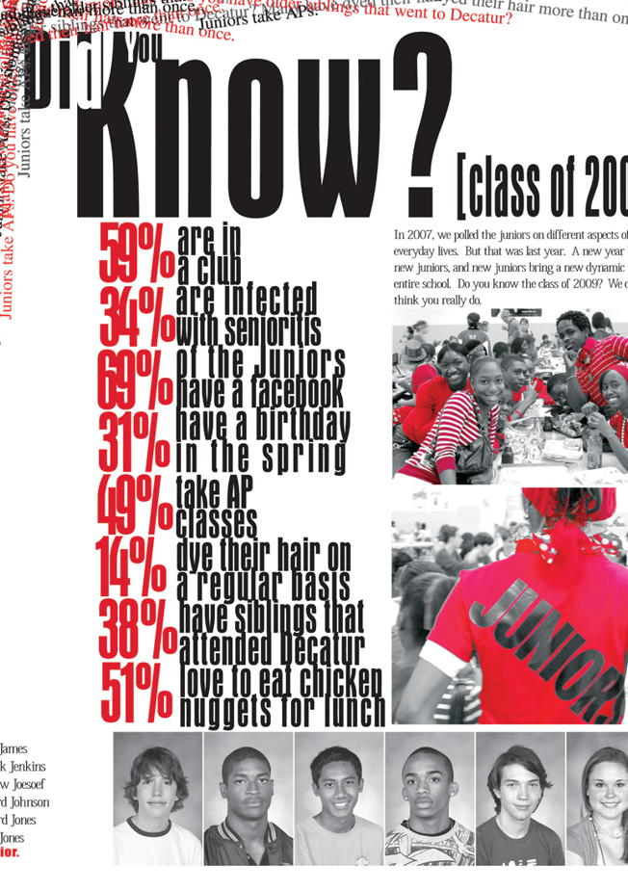
Infographics
What you need to know
Easy to Read People want highlights; numbers and bullets are cool.
2. Informative Increase the odds of people reading. Short and to the point.
3. Creative Combine colors with your theme-the perfect match. They are entertaining.
4. Marketing Tool Create for yearbook and post on social media sites.
5. Space-saving A lot of information into a small space on the spread.
Mod 8: Five Points to Consider when Working with Infographics

Slide 13
Mod 8
It is a Mod:
Do the items that is best for your staff!
Possibilities
Video/PowerPoint of Colors, Fonts, Infographics with Follow-up handouts and discussion.
Ten activities, (Three activities on Colors, Four activities on Fonts, and Three activities on infographics)
Resources-Two PowerPoints on Colors and Fonts/Typography; Two-word docs on 10 Points to Consider with Fonts and Using Infographics.
Evaluation of Mod 8 (Two Quizzes) (Fonts Colors Infographics), and Assessment

Slide 14
I Should Have
Known That!
Mod 8:
Colors, Fonts, Infographics
Blaze Bucks

Slide 15
I Should Have
Known That!
Each Mod Lesson I will begin with a challenging, fun question.
At end of lesson, I will give you the answer.
Each week, two winners of $5.00 Starbucks Gift Card.
Staffs will be on different Mods, but no problem!
Let’s have some fun!
Blaze Bucks

Slide 16
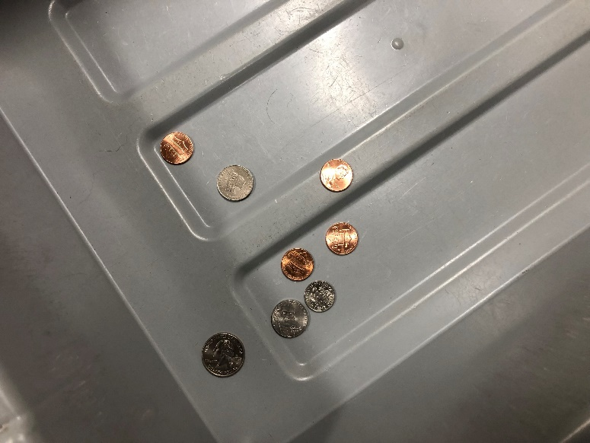
$452,300
$578,983
$723,123
$843,756
$960,105
I Should Have
Known That!
The amount of money left at US airport checkpoints in the 2019 fiscal year is:
Money consisted of:
loose change and paper currency that passengers removed from their pockets and left behind in a bin during the security screening process at TSA checkpoints.
Kansas, Montana, North Dakota Reps:
Jeff Bell, Executive Vice President of Sales-Kansas
Keith Hughey, Sales Manager-Kansas
Reggie Jackson-North Dakota
John Kelley-Kansas
Kati Patterson-Montana
Anne Scott-Montana
Tracy Tuley, CJE-Kansas
Blaze Bucks

Slide 17
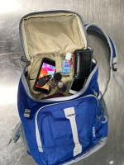
$452,300
$578,983
$723,123
$843,756
$960,105
I Should Have
Known That!
The amount of money left at US airport checkpoints in the 2019 fiscal year is:
Kansas, Montana, North Dakota Reps:
Jeff Bell, Executive Vice President of Sales-Kansas
Keith Hughey, Sales Manager-Kansas
Reggie Jackson-North Dakota
John Kelley-Kansas
Kati Patterson-Montana
Anne Scott-Montana
Tracy Tuley, CJE-Kansas
Top Five Airports Money Left Behind
John F. Kennedy International Airport - $98,110
San Francisco International Airport - $52,668.70
Miami International Airport - $47,694.03
McCarran International Airport - $44,401.76
Dallas/Fort Worth International Airport - $40,218.19
Blaze Bucks

Slide 18
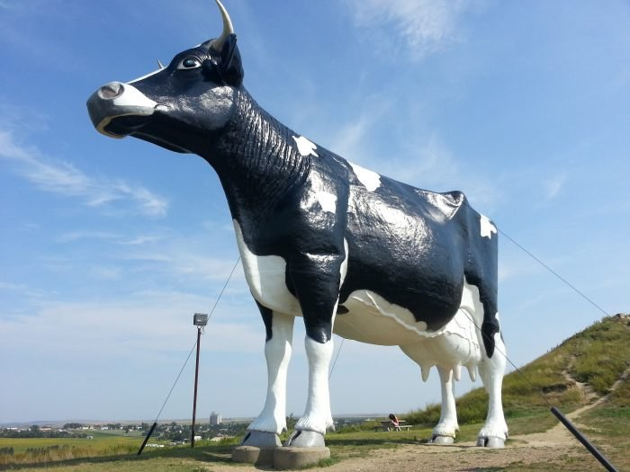
$452,300
$578,983
$723,123
$843,756
$960,105
I Should Have
Known That!
The amount of money left at US airport checkpoints in the 2019 fiscal year is:
Kansas, Montana, North Dakota Reps:
Jeff Bell, Executive Vice President of Sales-Kansas
Keith Hughey, Sales Manager-Kansas
Reggie Jackson-North Dakota
John Kelley-Kansas
Kati Patterson-Montana
Anne Scott-Montana
Tracy Tuley, CJE-Kansas
Kansas: All the wheat grown in Kansas in a single year would fit in a train stretching from western Kansas to the Atlantic Ocean.
Montana: Ted Turner, the owner and founder of CNN, was born in Montana
North Dakota: One of the most popular giant roadside sculpture is Salem Sue, the world’s largest Holstein cow. It is right outside of the city of New Salem.
Blaze Bucks

Slide 19
$452,300
$578,983
$723,123
$843,756
$960,105
I Should Have
Known That!
The amount of money left at US airport checkpoints in the 2019 fiscal year is:
Kansas, Montana, North Dakota Reps:
Jeff Bell, Executive Vice President of Sales-Kansas
Keith Hughey, Sales Manager-Kansas
Reggie Jackson-North Dakota
John Kelley-Kansas
Anne Scott-Montana
Tracy Tuley, CJE-Kansas
$960,105
Blaze Bucks

