Slide 1
Online Design
Power and Convenience
Mod 4:
Beginning Online Design-Part 2

Slide 2
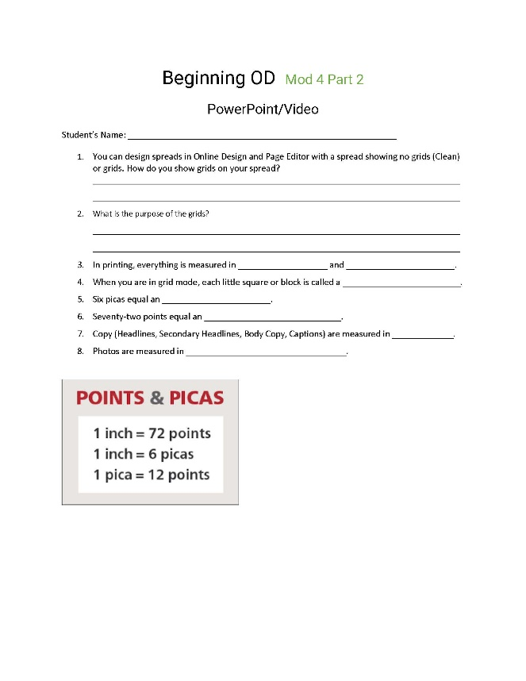
Online Design
Power and Convenience
Three Simple Reasons to use
Online Design

Slide 3
Online Design
Simple
Same functionality as InDesign and but in manageable pieces.
Online Design
Self-Contained
Mod 4:
Online Design: The Three S’s
Simple, Self-Contained, Stimulating
All the tools you will need.
Online Design
Stimulating
Visual stimulating interface and bright designs; Easy to learn,

Slide 4
Online Design
Basic Training
Part 1, Step 1: Uploading Images to OD
Part 1, Step 2: Recommending Photos to Spreads/People
Part 1, Step 3: Page Editor Tools
Part 1, Step 4: Page Editor Tools
Undo/ Redo Selection Tool Text Tool
Draw tool Shapes tool Hands Tool Zoom Tool
Part 2, Step 1: Menus
Part 2, Step 2: Palettes
Part 2, Step 3: Templates
Mod 4:
Online Design Basics
Plus
Six Training Videos

Slide 5
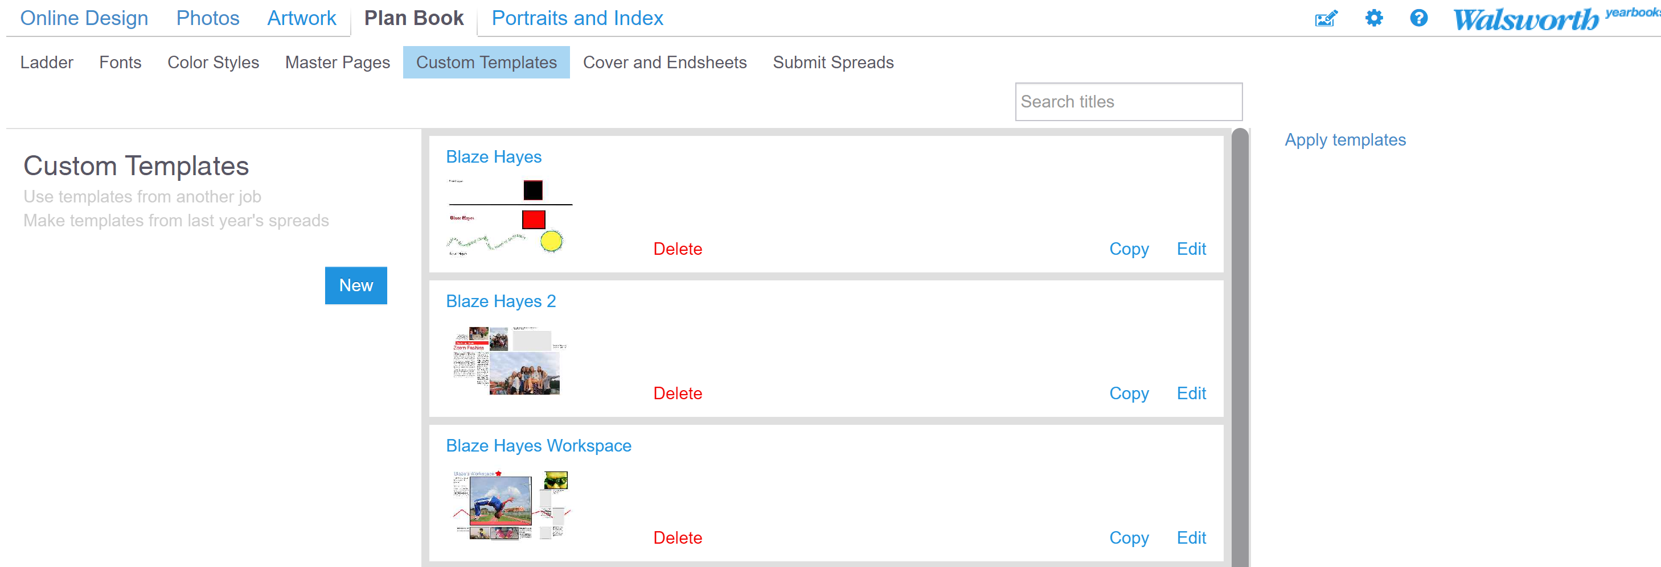
Online Design
Training
Menus
Mod 4:
Online Design:
Plan Book
Custom Template
New-Name
Mod 4:
Online Design:
Plan Book
Custom Template
New-Name

Slide 6
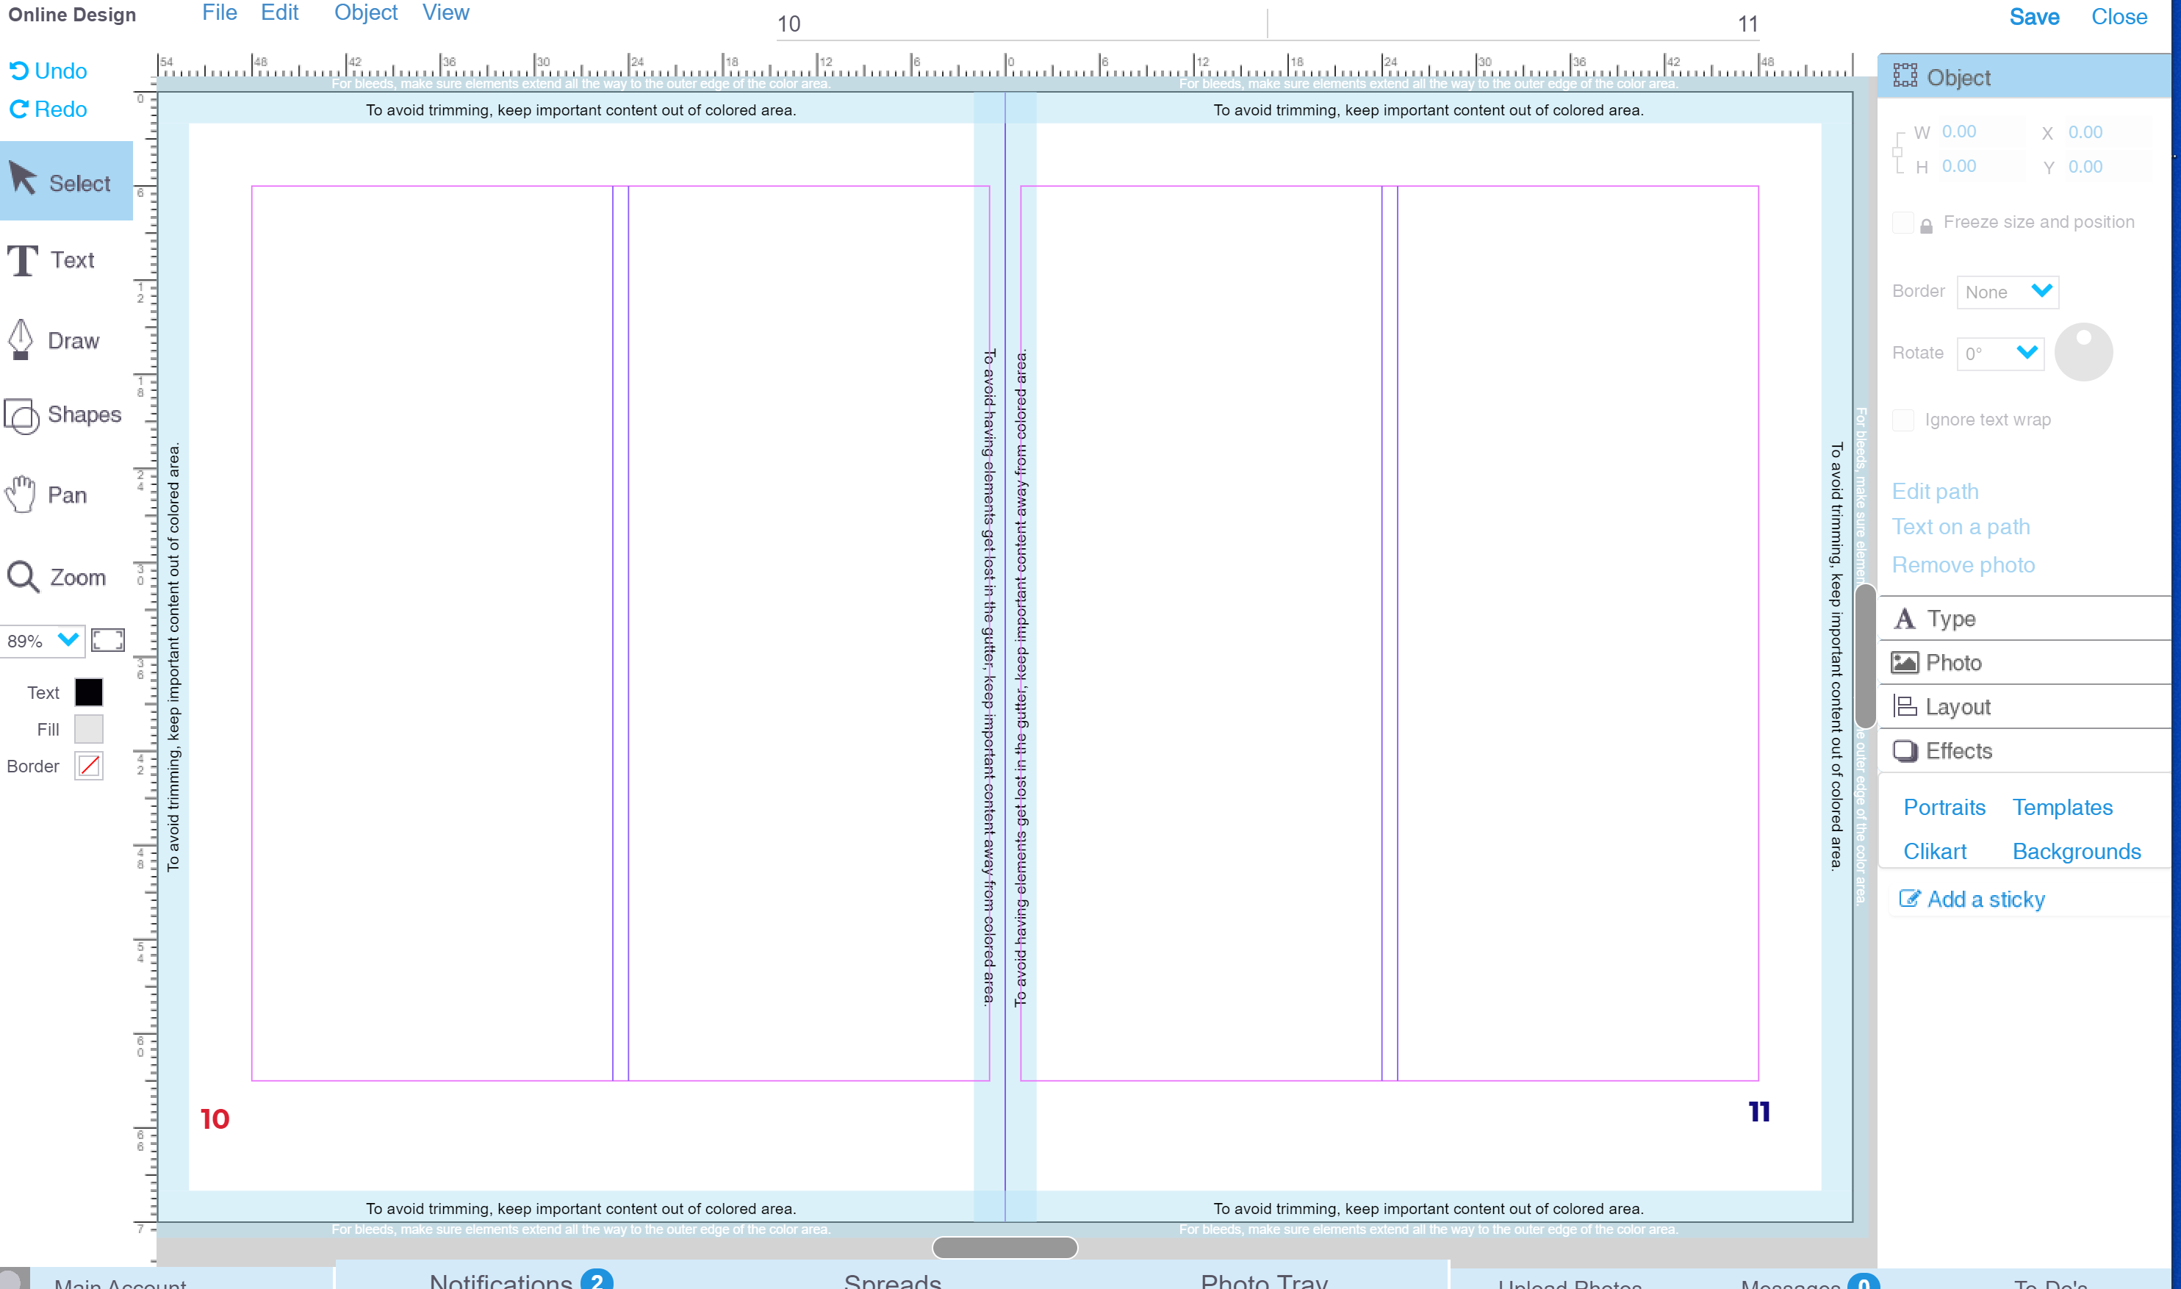
Online Design
Training
Tools
Menus
Palettes
Left: Tools (TL)
Right: Palettes (PR)
Top: Menus (MT)
Mod 4:
Online Design:
Three Amigos
Tools, Menu Palettes

Slide 7
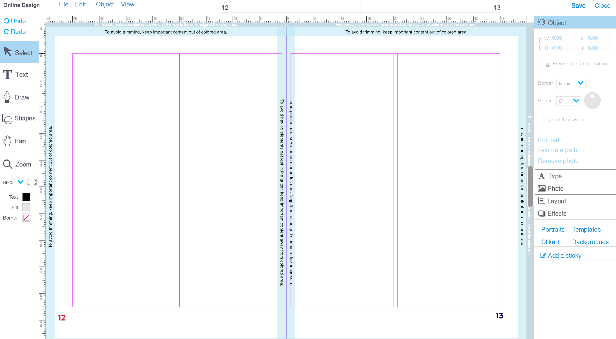
Online Design
Training
Clean Spread
Mod 4:
Online Design Basics
Plus
Six Training Videos

Slide 8
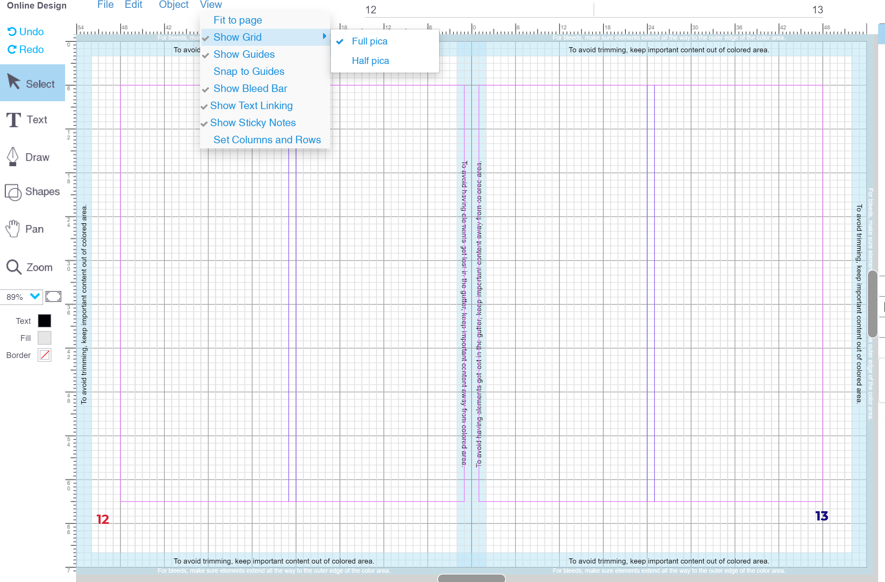
Online Design
Training
Mod 4:
Online Design Basics
Plus
Six Training Videos
Grid Spread

Slide 9
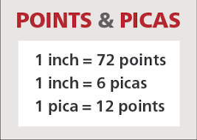
Online Design
Training
Measure photos in Picas.
Measure type and lines in Points.
Each little block is a Pica.
Six of the Picas equal an inch
An inch or 6 Picas equal 72 Point.

Slide 10
Online Design
Training
Training OD Photos Basic Sarah Balduff
Training OD Intermediate Spencer Vanover
Training OD Intermediate Tips and Tricks Katie Rice
Training OD for Editors Lindsey Swank
Training OD Photos Advanced Lori Mortland, CJE
Training OD Advanced Kris Hemry
Mod 4:
Online Design Basics
Plus
Six Training Videos

Slide 11
Online Design
Training
Training OD for Editors Lindsey Swank
Athens, Ohio
Home to one of the largest Halloween block parties in the nation!
Training OD for Editors
To Do, Sticky Notes, Choosing Fonts, Colors, Master Pages, Folios, Type Style
lindsey.swank@walsworth.com

Slide 12
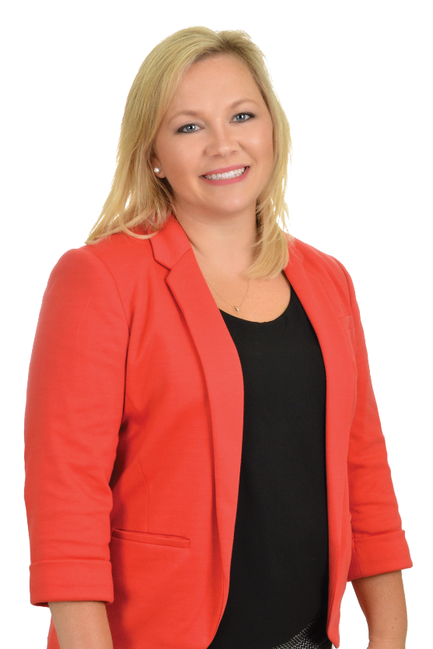
Online Design
Training More Exercises
Training OD Photos Advance Lori Mortland, CJE
Batchtown, Illinois
Yearbook adviser for 14 years for an extra-curricular staff
Never used the same ladder twice
Had one rule: "If it's been done before, let's try something different".
Training OD Photos Advance:
Photo Albums
Search, Recommended, Tagging
Photo Editor vs Photopea
COB (Cut Out Background)
lori.mortland@walsworth.com

Slide 13
Online Design
Training
Training OD Advance Kris Hemry
Jackson, Michigan
On Twitter it says, “yearbook, baseball and family; not in that order”.
If not working on yearbooks you will find him coaching his kids in sports of all kinds.
Training OD Advance
Columns and Grids
Alignment and Spacing
Headlines-Photo in Text, Text on a Path
kris.hemry@walsworth.com

Slide 14
Mod 4
It is a Mod:
Do the items that is best for your staff!
Possibilities
Video/PowerPoint of Beginning Online Design Part 1 with Follow-up handout and discussion
Video/PowerPoint of Beginning Online Design Part 2 with Follow-up handout and discussion
Seven activities (Handouts) on Beginning Online Design, (Uploading Photos, Recommending Photos, Page Editor Tools (2), Menus, Palettes, and Templates)
Resources-OD Manual, Getting to Know Page Editor, Uploading Images
Evaluation of Mod 4 (5 Quizzes) (Uploading/Recommending Photos, Tools, Menu, Palette, Show Me Your Workspace), and Assessment
Additional OD Midwest Reps Videos and Activities (Training OD Photos Basic, Training OD Intro, Training OD Intermediate, Training OD for Editors, Training OD Photos Advance, and Training OD Advance)

Slide 15
Mod 4
It is a Mod:
Do the items that is best for your staff!
Possibilities
OD Introduction: Design a page containing a photo with a stroke in a bright color, a smaller version of the same photo, two boxes of text using obviously different fonts, and a filled-color shape layered behind another element; save this design and submit to your instructor using a method of his/her choice.
OD Intermediate: Create an example of a personal or business ad that bleeds off the page and includes a business or student name in a text box, a group of 3 images, use of transparency, an object with a gradient, application of the drop shadow on an element, and a unique shape with >4 sides; save this design and submit to your instructor using a method of his/her choice.
OD Advance: Design a full page grid-style photo collage (can be all same image or different images) using equal vertical and horizontal spacing and even lines around all sides; include a title containing a photo in text, a subtitle that applies text-on-a-path, and a caption that wraps around an image; save this design and submit to your instructor using a method of his/her choice.

Slide 16
Mod 4
It is a Mod:
Do the items that is best for your staff!
Possibilities
OD Photos Introduction: Upload 4 photos you’ve taken of ‘school life’ to a folder in OD entitled PI[+yourlastname]; place those images onto a page with a different photo effect(s) on three of them [one will remain original version; effects should make images obviously different from one another] and crop one to show a single portion of a face; save this design and submit to your instructor using a method of his/her choice.
OD Photos Advanced: Recommend a full-length image of yourself to your adviser; Recommend an image of your workspace to page 1; Mark a selfie of you in your favorites and place it on a spread three times; one stays original, create a single straight-line clipping path on a different one, and the third with a mixture of straight and curved lines cut out of at least one edge using clipping path; save your page work and submit to your instructor using a method of his/her choice.
OD for Editors: Customize a template for your book based on one from the template library--place a sticky with the name of the original template somewhere on the layout—your design must include a locked element (label this), a frozen element (label this), and two saved type styles; save your work and submit to your instructor using a method of his/her choice.

Slide 17
I Should Have
Known That!
Mod 4:
Beginning Online Design-Part 2
Blaze Bucks

Slide 18
I Should Have
Known That!
Each Mod Lesson I will begin with a challenging, fun question.
At end of lesson, I will give you the answer.
Each week, two winners of $5.00 Starbucks Gift Card.
Staffs will be on different Mods, but no problem!
Let’s have some fun!
Blaze Bucks

Slide 19
I Should Have
McDonald’s
Walmart
Grocery Store
Doctor’s Office
Post Office
Known That!
Each week, nearly 1/3 of the US population visits this place?
Illinois and Michigan:
Deanne DeMare-Michigan
Kris Hemry-Michigan
Kathryn Hurley-Illinois
Lori Mortland, CJE-Illinois
Shelley Mosley-Illinois
Mark Sigman, Manager-OH
Mary Slater, CJE-Illinois
Lisa Sparks-Michigan
Jim Straub-Illinois
Valerie T. Tanke, CJE-Michigan
Suzanne Young-Michigan
Kris Hemry
Lori Mortland
Lindsey Swank
Blaze Bucks
Mark Sigman

Slide 20
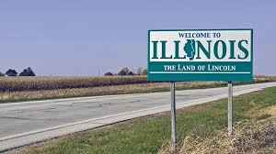
McDonald’s
Walmart
Grocery Store
Doctor’s Office
Post Office
I Should Have
Known That!
Each week, nearly 1/3 of the US population visits this place?
The first McDonald's was built in
Des Plaines, Illinois
Twinkies were first invented in River Forest, Illinois in 1930.
Michigan has more miles of freshwater shoreline than any other state in the nation.
Stand anywhere in Michigan, and you’re within 85 miles of a Great Lake.
Blaze Bucks

Slide 21
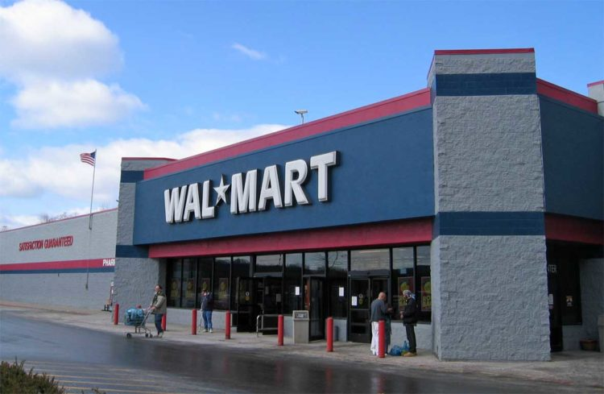
McDonald’s
Walmart
Grocery Store
Doctor’s Office
Post Office
I Should Have
Known That!
Each week, nearly 1/3 of the US population visits this place?
Based in Bentonville, Arkansas; In all 50 states.
37 million people shop at Walmart every day; that’s more than the population of Canada.
90% of American live within
15 minutes of a Walmart.
Walmart has 2.2 million employees;
that’s more than the people of Houston.
Blaze Bucks

