Slide 1
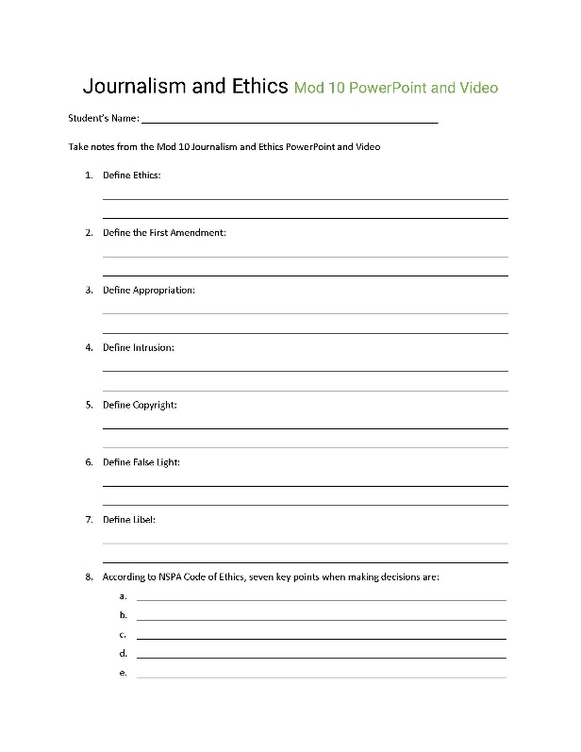
Journalism
And Ethics
Mod 10: Ethics is a system of moral values, principles of right or good conduct. Your staff manual should include basic principles of scholastic press law, such as First Amendment status, libel, copyright and other topics of legal concern.
Yearbook staffs are responsible for creating a yearbook publication that becomes the permanent record of the school they serve.
It is a record/history book for many years to come.
Because the publication is a historical document, the ethical questions facing the yearbook staff are challenging.

Slide 2
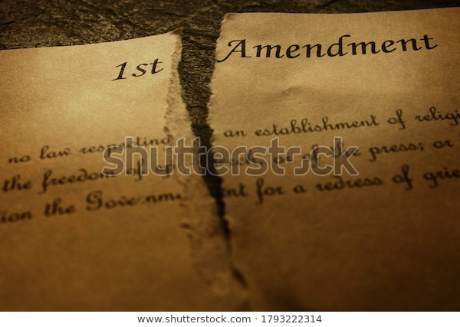
First Amendment
Congress shall make no law respecting an establishment of religion or prohibiting the free exercise thereof; or abridging the freedom of speech, or of the press; or the right of the people peaceably to assemble, and to petition the Government for a redress of grievances.
Appropriation
Mod 10-Definitions: You may have a great idea for your yearbook, but have you considered whether you have the legal right to include it in your publication?
A person’s name or photograph cannot be used for commercial use without written consent. A photo of the homecoming queen on a poster with a bubbled message reading, “You’ll be my king if you buy a yearbook today” is illegal without written consent.
Intrusion
People in public places have no right to privacy, but restrooms, locker rooms and individuals’ homes are considered private. A reporter cannot take pictures in these settings without consent.

Slide 3
Copyright
Under this law, the following forms of “art” are protected: Literature, Music, Lyrics, Plays, Choreography, Pictures, Photos, Sculptures, Graphics, Movies, Audiovisual Works, Sound Records. A collage of copyrighted materials (CD covers, photos, magazine covers, etc.) may be photographed to demonstrate current trends.
False Light
Mod 10-Definitions: You may have a great idea for your yearbook, but have you considered whether you have the legal right to include it in your publication?
Information reported, and photographs taken are true, however if they imply something false, then this is false light. A picture of four athletes taking a water break during practice adjacent to the story on athletes breaking the substance abuse policy, implies these fours are guilty.
Libel
A statement printed as fact that is false and attacks a person’s reputation.

Slide 4
Seven Key Points
When Making Tough Decisions
Be responsible.
Be fair.
Be honest.
Be accurate.
Be independent.
Minimize harm.
Be accountable.
Mod 10: When you decide to publish something, ask yourself is it ethical?
NSPA Code of Ethics

Slide 5
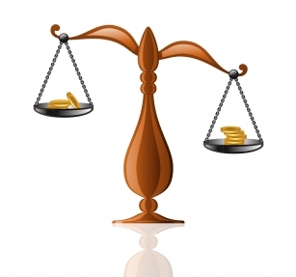
Copyright Laws
Copyright law protects the works of authors, including musical, dramatical and literary works. A copyright protects the way in which a creator expresses his or her idea, but not the actual idea or facts behind the idea. Copyright protection is unavailable for names, titles of books and movies, slogans, and short advertising expressions.
Copyrighted Works
Mod 10: Copyright Law
It is important to establish clearly who owns the copyright to your yearbook and the elements that comprise it, such as the photos, designs, stories, and graphics. The publication itself often controls the use of yearbook content by sources outside of the staff..
Only the creator of a copyrighted work or the owner of a copyright is legally allowed to reproduce, perform, display, distribute copies of or create variations of a work. Any unauthorized use of a copyrighted work is copyright infringement. If you include a piece of copyrighted material in your yearbook without obtaining permission from the copyright owner, you can be sued for copyright infringement.

Slide 6
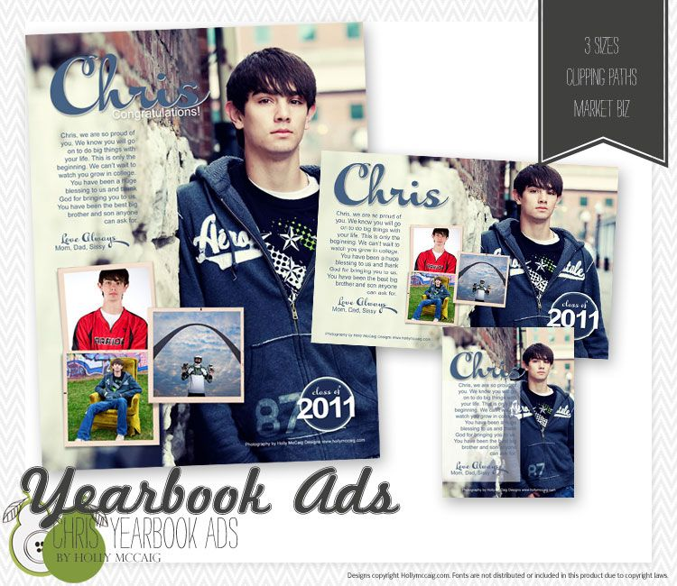
Advertisements
Acceptance/Refusal
Any publication has the right to refuse advertising before a formal contract is signed between the advertiser and the publication. Refusal can be for any number of reasons:
The staff disagrees with the position taken in an advocacy ad.
The staff chooses not to accept ads that concern specific controversial issues, such as abortion or birth control.
The staff feels an ad promotes a product that is harmful to students.
Mod 10: While you might consider an ad to be any content in the book for which a customer pays, not all ads are created equal in the eyes of the law.

Slide 7
Mod 10
It is a Mod:
Do the items that is best for your staff!
Possibilities
Video/PowerPoint of Theme Development with Follow-up handouts and discussion.
Six activities, (Ethics Getting Started, Definitions, First Amendment, Two on Copyright, and Advertisements and Ethics)
Resources-Two PowerPoints on Ethics and the Law; Handouts/Readings on Ethics in advertising, NSPA code of Ethics, Yearbook Suite, Make the Commitment to Create an Ethical Yearbook, Ready Made Guiding Light, Copyright in the Time of Corona.
Evaluation of Mod 10(Two Quizzes) (Objective and Subjective), and Assessment

Slide 8
I Should Have
Known That!
Mod 10:
Journalism and Ethics
Blaze Bucks

Slide 9
I Should Have
Known That!
Each Mod Lesson I will begin with a challenging, fun question.
At end of lesson, I will give you the answer.
Each week, two winners of $5.00 Starbucks Gift Card.
Staffs will be on different Mods, but no problem!
Let’s have some fun!
Blaze Bucks

Slide 10
They are already in a relationship.
Poor hygiene.
Talking about an ex.
Ordering a healthy meal.
Being on your telephone.
I Should Have
Known That!
According to one of the top dating outlets, the number one deal breaker on a first date is:
A study shows that women are attracted to men wearing blue.
According to one dating specialist, never cook dinner for someone until the third date is completed.
Movie theaters and restaurants are not good places for date.
Malls, coffee shops, colleges and schools are better places for dating because they are more open.
New York Reps:
Jessica Crokos, Wantagh, New York
Katie Smith, Livonia, New York
John St. Pierre, Hauppauge, New York
Blaze Bucks

Slide 11
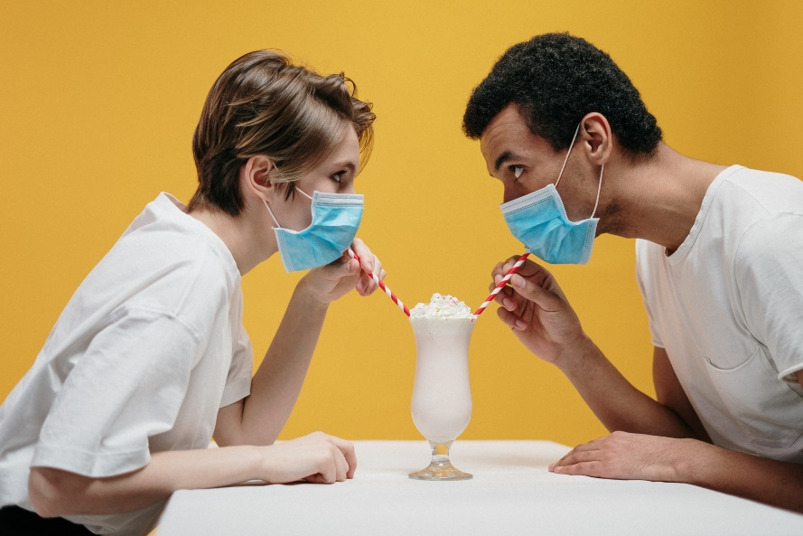
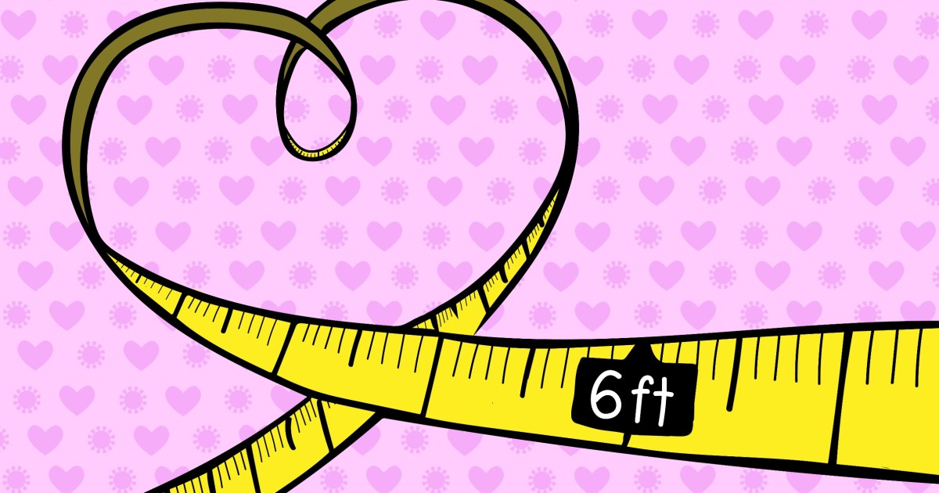
They are already in a relationship.
Poor hygiene.
Talking about an ex.
Ordering a healthy meal.
Being on your telephone.
I Should Have
Known That!
According to one of the top dating outlets, the number one deal breaker on a first date is:
Saying the name of the other person at least twice during a conversation in a date leads to instant link. That is because saying out the name means connectiveness and attentiveness.
New York Reps:
Jessica Crokos, Wantagh, New York
Katie Smith, Livonia, New York
John St. Pierre, Hauppauge, New York
Blaze Bucks

Slide 12
They are already in a relationship.
Poor hygiene.
Talking about an ex.
Ordering a healthy meal.
Being on your telephone.
I Should Have
Known That!
According to one of the top dating outlets, the number one deal breaker on a first date is:
Top 5 Cities Where Most People are Single
Tallahassee, FL- Single Population 59.1%
4. Lawrence, KS-Single Population 59.6%
3. Gainesville, FL-Single Population 60.7%
2. Bloomington, IN-Single Population 60.9%
Ithaca, NY-Single Population 61.6%
New York Reps:
Jessica Crokos, Wantagh, New York
Katie Smith, Livonia, New York
John St. Pierre, Hauppauge, New York
,
Blaze Bucks

Slide 13
They are already in a relationship.
Poor hygiene.
Talking about an ex.
Ordering a healthy meal.
Being on your telephone.
I Should Have
Known That!
According to one of the top dating outlets, the number one deal breaker on a first date is:
New York Reps:
Jessica Crokos, Wantagh, New York
Katie Smith, Livonia, New York
John St. Pierre, Hauppauge, New York
A. They are already in a relationship.
Blaze Bucks

